Slide 1



AWS Lambda
Serverless Computing in AWS
Cloud Computing Session | 2024 - 2025

Slide 2



Introduction to AWS Lambda
Serverless Compute Service: Run code without managing or provisioning servers.
Zero Management: AWS handles hardware, OS, and runtime maintenance.
Automatic Scaling: Automatically scales from a few requests to thousands per second.
Event-Driven: Perfect for responsive, real-time application workloads.

Slide 3




What is Serverless Computing?
Focus on Code
Developers spend time on logic, not infrastructure configuration.
Managed Availability
High availability and fault tolerance are built directly into the service.

Slide 4






Key Features
No Servers
Scaling
Pay-per-use
Completely abstracts the underlying hardware and operating system.
Instantly scales up or down based on the incoming request traffic.
Charged only for the milliseconds your code actually executes.

Slide 5



How AWS Lambda Works
1. Upload
2. Trigger
3. Execute
4. Return
Upload your code as a ZIP file or container image.
Define an event trigger from an AWS service (e.g. S3).
Lambda runs your function only when triggered.
Process the data and return a response or output.

Slide 6
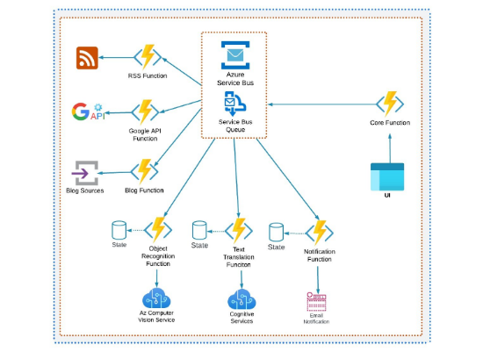


High-Level Architecture
Event Source: The trigger (e.g., API request, file upload).
Lambda Function: Your actual application code.
Execution Env: Temporary isolated compute runtime.
Output: Response sent to user or next service.

Slide 7



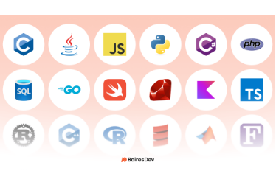


Supported Programming Languages
Python & Node.js
Java & C#
Go & Ruby

Slide 8






Common Triggers / Event Sources
Amazon S3
API Gateway
DynamoDB
Process files immediately after upload.
Build RESTful endpoints for web apps.
Trigger logic based on database changes.

Slide 9
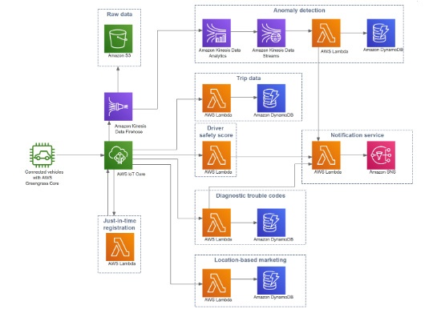
Integration with AWS Services
Works with Amazon S3 for storage tasks.
API Gateway for secure API backends.
DynamoDB Streams for data workflows.
CloudWatch for logs and monitoring.

Slide 10




Advantages of AWS Lambda
Operational Simplicity: No servers to maintain or patch.
Scale Automatically: Handles spikes without manual effort.
Cost Efficiency: No payment for idle compute time.
Reliability: Built-in redundancy and high availability.

Slide 11



Limitations & Considerations
Execution Time
Cold Starts
Short-running
Max timeout is 15 minutes per invocation.
Slight delay during initial initialization.
Not ideal for multi-hour processing tasks.

Slide 12
AWS Lambda Pricing Model
1M
400k
Pay per Request: $0.20 per 1 million requests. Pay per Execution: Based on memory size and compute time.
Requests Free
GB-Sec Free

Slide 13

Example: Image Processing
User uploads photo to S3 bucket.
S3 sends Trigger to Lambda.
Lambda Resizes the image instantly.
New image saved to Another S3 bucket.

Slide 14




Best Practices for Success
Small & Focused: Keep functions specialized (one task per function).
IAM Roles: Use least-privilege permissions for security.
Monitoring: Always use CloudWatch for logs and metrics.
Optimization: Tune memory and timeout settings for efficiency.

Slide 15

AWS Lambda simplifies application deployment and powers modern event-driven architectures with high scale and low cost.
Conclusion

Slide 16






Image Sources
https://miro.medium.com/1*Gxz-GjfXj4nzJxU472kvzw.png
Source: itnext.io
https://static.vecteezy.com/system/resources/previews/046/118/794/non_2x/serverless-computing-concept-flat-illustration-vector.jpg
Source: www.vecteezy.com
https://imgopt.infoq.com/fit-in/3000x4000/filters:quality(85)/filters:no_upscale()/articles/event-driven-architecture-clouds/en/resources/35figure-1-1687173481115.jpg
Source: www.infoq.com
https://bairesdev.mo.cloudinary.net/blog/2020/10/top-programming-languages.png?tx=w_1920,q_auto
Source: www.bairesdev.com
https://sparxsystems.com/products/ea/15.2/images/aws-connected-vehicle-solution.png
Source: sparxsystems.com
https://cdn-icons-png.flaticon.com/512/9423/9423110.png
Source: www.flaticon.com

